Slide 1
SPACE ASTEROID DETECTION APP
User Manual
BY- Suhina Bhola

Slide 2
TABLE OF CONTENTS
01
02
03
04
About Me..
About My Internship Journey with
Clevered..
About App..
Acknowledgements

Slide 3
introduction!
My name is Suhina Bhola. I’m from Delhi, India and I was in grade 9 when i started this internship and now I’m going to grade 10. I’m a science student and plan to pursue science or AI in the future.

Slide 4
About My Internship Journey with
Clevered..
My AI internship has been transformative, offering hands-on experience with cutting-edge technologies. I've developed skills in data analysis, and algorithm development, working on projects in natural language processing and computer vision. Collaborating with experienced professionals has broadened my industry understanding and provided invaluable mentorship, enhancing my technical and problem-solving abilities for a future in AI.

Slide 5
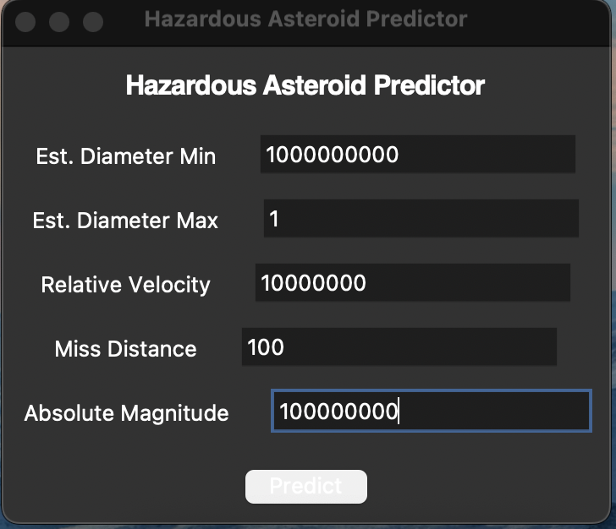
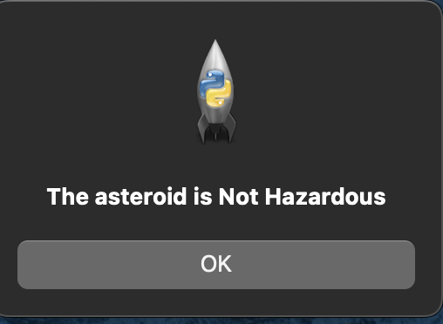
About app- introduction
The image depicts a software application called "Hazardous Asteroid Predictor," designed to evaluate the potential danger posed by asteroids. The main interface allows users to input various parameters such as estimated diameter, relative velocity, miss distance, and absolute magnitude. This website helps users put in data for an asteroid of their choice and further deduct whether or not this asteroid could b potentially dangerous.

Slide 6
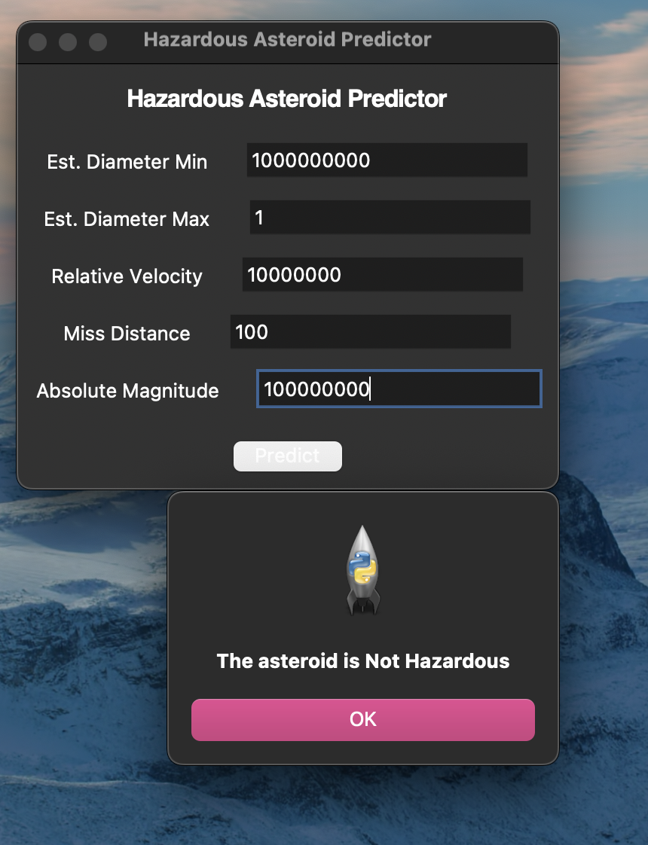
About app
The image depicts two main parts of the "Hazardous Asteroid Predictor" app. The top section features the main menu, where users can input data such as estimated diameter (minimum and maximum), relative velocity, miss distance, and absolute magnitude of an asteroid. After entering these values, users can click the "Predict" button to analyze the asteroid's potential threat. The bottom section shows the result of this analysis, with a pop-up message indicating that "The asteroid is Not Hazardous." The app's straightforward design ensures that users can easily input data and quickly receive a hazard assessment.

Slide 7
Contact Me
Please reach out to me at suhinabhola2009@gmail.com if you have any questions/ suggestions about the app

Slide 8
Acknowledgements
Thank You to everyone who has helped me on this journey. Special thanks to Dr.Ken, and my mentor Avishek sir

Slide 9
ANY QUESTIONS OR FEEDBACK?
Clevered
THANK YOU FOR LISTENING
By Suhina Bhola

